Slide 1


Graph-Based Deep Learning for Predicting and Interpreting Peptide–Molybdenum Binding from Experimental Elution Data
Student: Domenico Zianni Degree Program: Bioinformatics Supervisor: prof. Osman Ugur Sezerman
Collaborator: Dr. Muhammet Baldan
Hosting institution: Acıbadem Mehmet Ali Aydınlar University (ACU), 2026

Slide 2
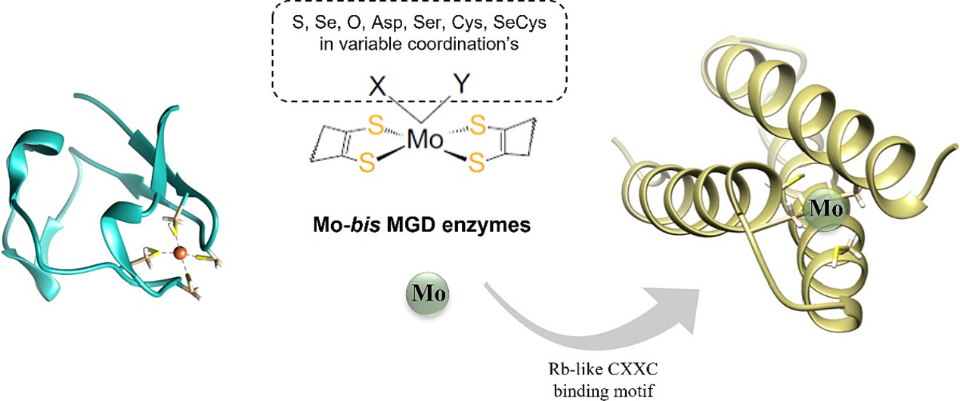
BIOLOGICAL BACKGROUND
Peptide–metal interactions are relevant in:
Biological catalysis
Biotechnology
Medical applications (e.g. prosthetics)
Molybdenum plays a central role in enzymatic cofactors
Short peptides can selectively bind metal ions and metal surfaces
Understanding peptide–molybdenum binding supports rational peptide design
Fig.1 ‘Incorporation of a Molybdenum Atom in a Rubredoxin-Type Centre of a de Novo-Designed α3DIV-L21C Three-Helical Bundle Peptide’, Journal of Inorganic Biochemistry, 240 (2023). doi:10.1016/j.jinorgbio.2022.112096

Slide 3
EXPERIMENTAL CONTEXT
Primary data derived from phage display
experiments
Molybdenum used as binding surface
Large peptide libraries screened for surface binding
Binding strength inferred through elution-based assays

Slide 4

ELUTION EXPERIMENT OVERVIEW
01
02
03
INCUBATION
WASH
SOLVENTS
04
05
AFTER WASH
RETAIN
Peptides incubated on molybdenum surface
Binding rate measured through sequential chemical washes
Three washes applied with different solvents
Peptides remaining bound to the surface are quantified
Peptides retained after stronger washes indicate stronger binding

Slide 5
DATA CHARACTERISTICS
SEQUENCE LENGTH
MEASUREMENTS
All peptides are 12 amino acids long (balance between diversity and functionality)
Binding measured across:
Initial binding
Multiple solvent wash conditions
CHEMICAL PROPERTIES
RETAIN FORCE
Binding behavior reflects:
Surface affinity
Resistance to chemical elution
Different wash conditions provide complementary binding information

Slide 6
DATASET CONSTRUCTION
Original experiment screened ~1 million peptides.
Peptides retrieved from fastq files. 3 samples for each wash sequenced 2 times
Multiple filtering steps applied to remove low-confidence sequences and reduce noise
Filtered datasets used to facilitate model training and evaluation

Slide 7
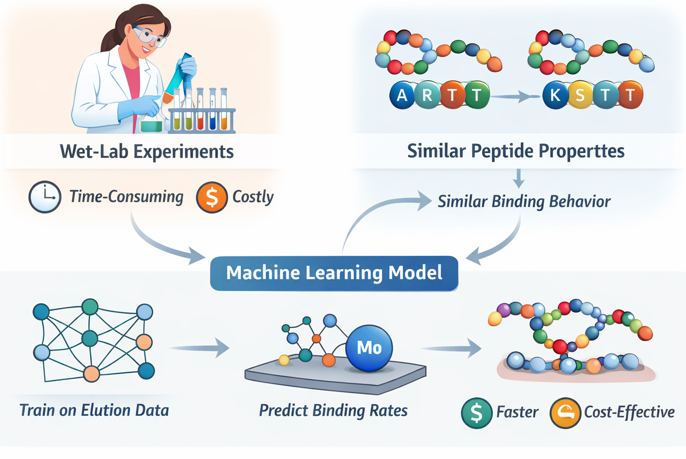
MOTIVATION FOR MACHINE LEARNING
1. Wet-lab binding experiments are:
Time-consuming
Costly
2. Peptides with similar physicochemical properties often show similar binding behavior
3. A machine learning model can:
Learn binding patterns from experimental data
Predict binding rates without additional wet-lab experiments

Slide 8

FEATURE REPRESENTATION
Peptides represented using:
Sequence-based encodings
Physicochemical descriptors
VHSE8 encoding:
Designed specifically for peptides
Compact representation
Demonstrated good performance in peptide-related tasks
Additional features integrated to improve predictive accuracy

Slide 9
GRAPH-BASED MODELING APPROACH
01
03
02
FUNCTION
TOPOLOGY
NODES FEATURES
Graph Neural Networks capture
local residue interactions and
global peptide-level patterns
Nodes → amino acid residues
Edges→ peptide bonds
VHSE8 physicochemical descriptors
Optional learned embeddings

Slide 10

EVALUATION & INTERPRETATION
DATA SPLIT
PERFORMANCE
INTERPRETABILITY
Dataset split into training, validation, and test sets
Correlation with experimental binding measurements
Regression error metrics
Identify residues and features contributing to binding and compare binding behavior across different wash conditions

Slide 11

AIMS & EXPECTED OUTCOMES
Develop a predictive model for peptide–molybdenum binding
Incorporate experimental elution data and physicochemical features
Improve prediction accuracy over simple sequence-based models
Support rational peptide design without additional wet-lab screening
Notes:
Limitations: - how to include secondary structure features in the model- we could do it using bioinformatics tools (e.g PDBeFold) to retrieve ss info, in this way we can set 3D coordinates of each aa as node features and distances as edges features
-how to let the model predict 3 different values for each peptide- first we will try to use coam (average wassh value for each peptide) and integrate ss info, then we can try to use three different washes for each sample

Slide 12

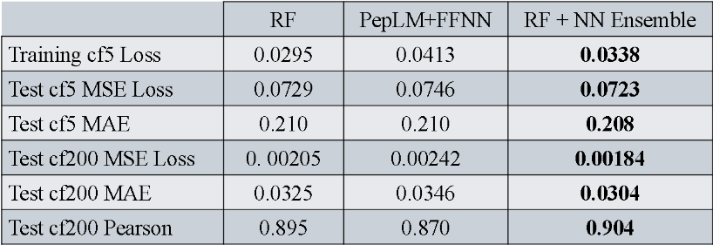
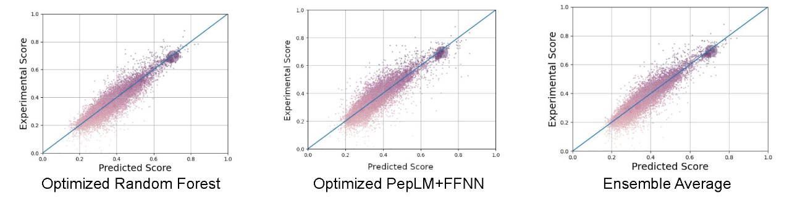
PREVIOUS RESULTS
Fig 2,3. Table and set of three scatter plots comparing predicted loss rates and scores versus experimental scores for different models. Each plot features a diagonal reference line, with data points densely clustered around it, indicating strong correlation and accuracy across models. Source: Öğüt, 2024

Slide 14


THANKS
Do you have any questions?
All the materials, dataset and scripts are available on the GitHub repository

